Slide 1

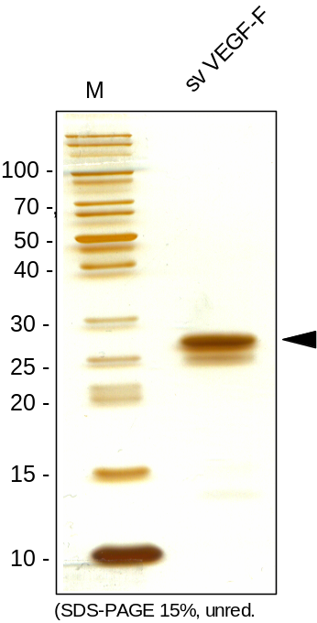
ReliaTech GmbH
Recombinant snake venom VEGF-F
(Cat #300-096S / -096 / -097)
Fig. 1: SDS-PAGE analysis of recombinant snake venom VEGF-F produced in E. coli. Sample was loaded in 15% SDS-polyacrylamide gel under non-reducing conditions and stained with Silver stain.
http://www.reliatech.de / orders@reliatech.de

